Slide 1
Coupon Monster
Cmpe 436 Term Project
Serkan Özel

Slide 2
Contents
Motivation
Project Features
Source Code
Demo

Slide 3
Motıvatıon
Discount coupons app
Good for advertisement
Compete while improving math skills
Shared resource -> Coupon solving screen
Actually, not a game but involves a game which makes it fun.

Slide 4
Project FEATURES
Coupon winning application
Gain coupons and scores by solving math problems
Compete with others
Default username and name, can change
Scoreboard
Coupons you win

Slide 5
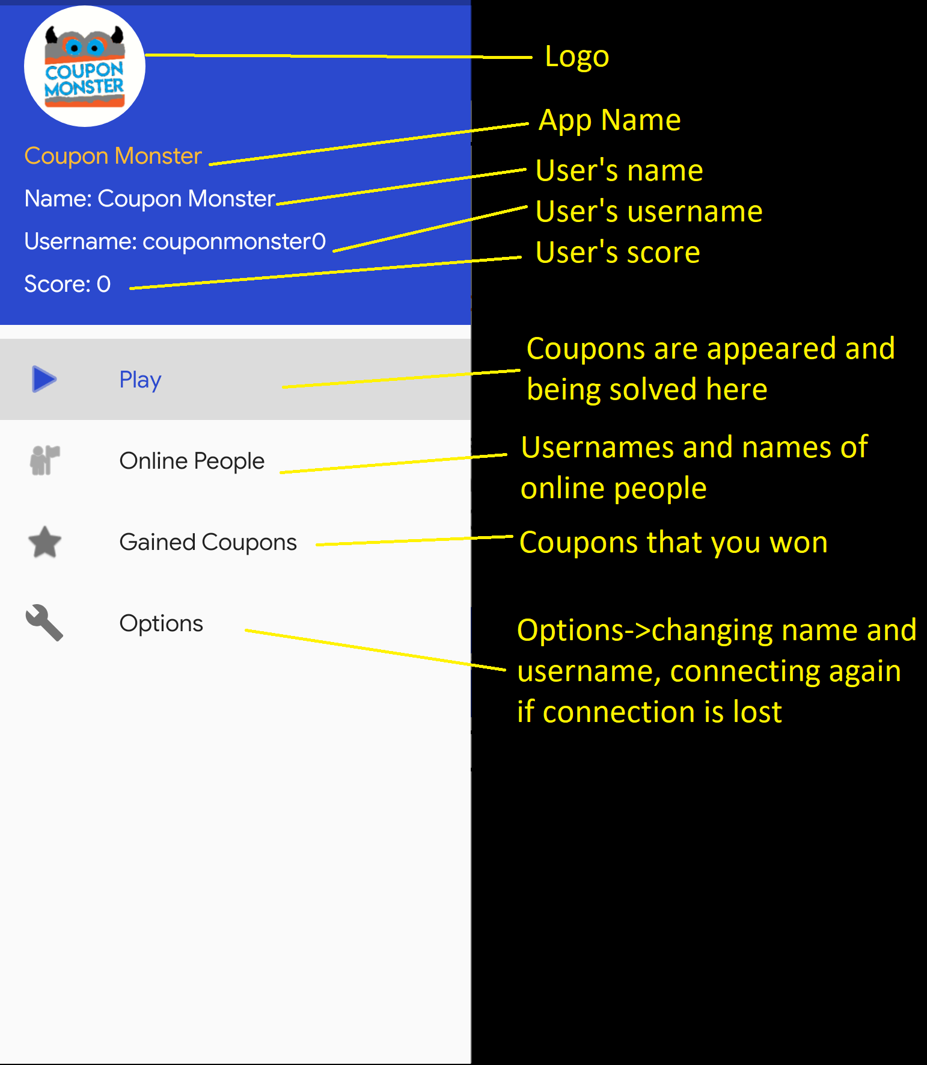
MENU

Slide 6
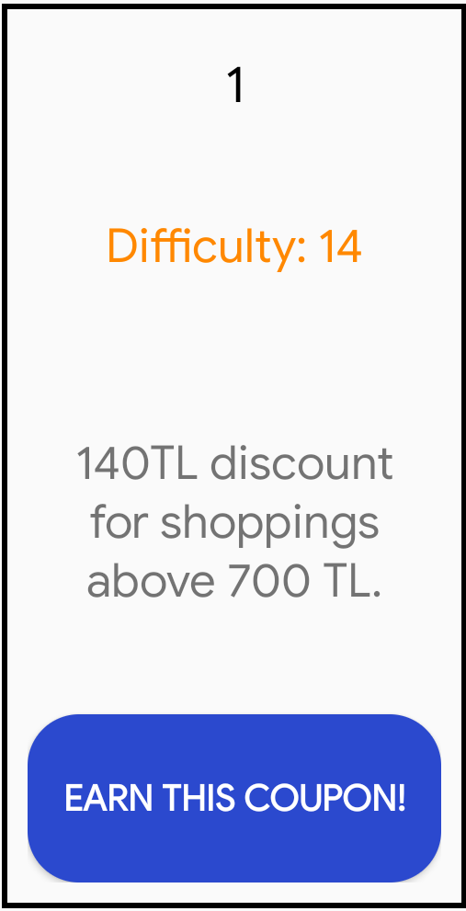
A Coupon
A coupon consists of:
Coupon Number -> Just for enumeration
Difficulty -> From 1 to 20
Coupon Text -> Text explaining the coupon
Discount -> (difficulty*10)
For shoppings above -> (difficulty * 50).’
Button to attempt solving the coupon problem

Slide 7
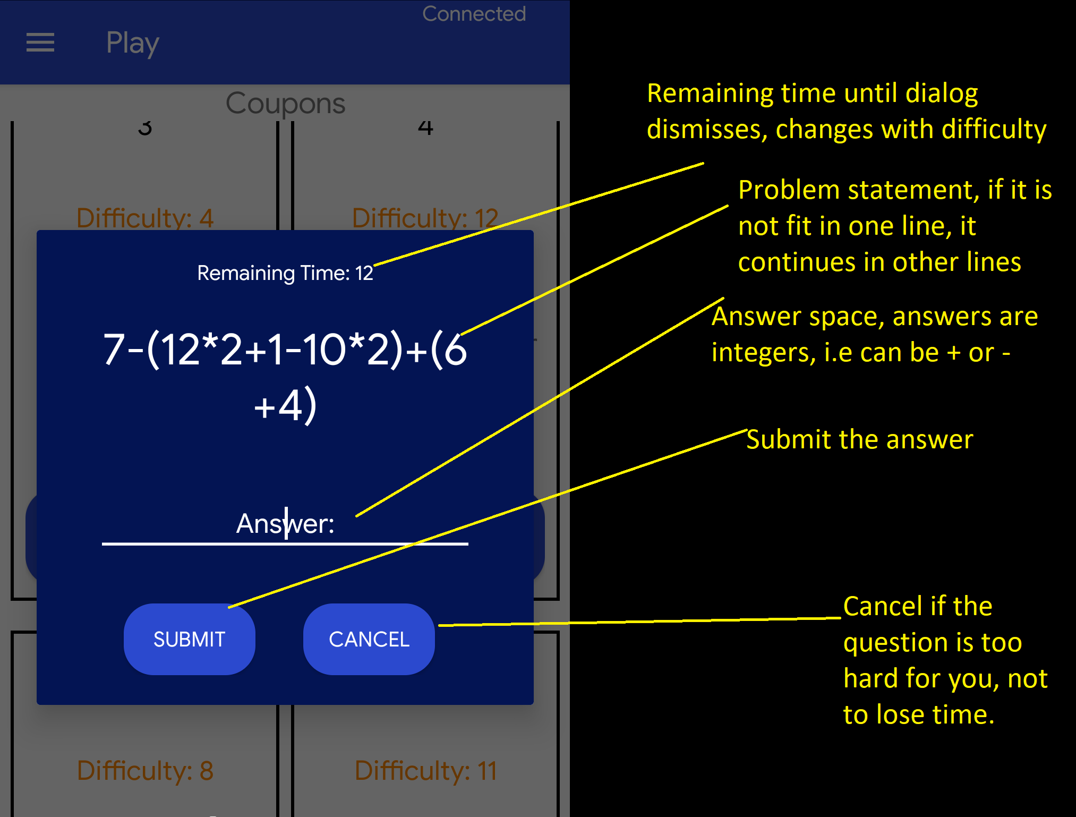
QUESTIONS

Slide 8
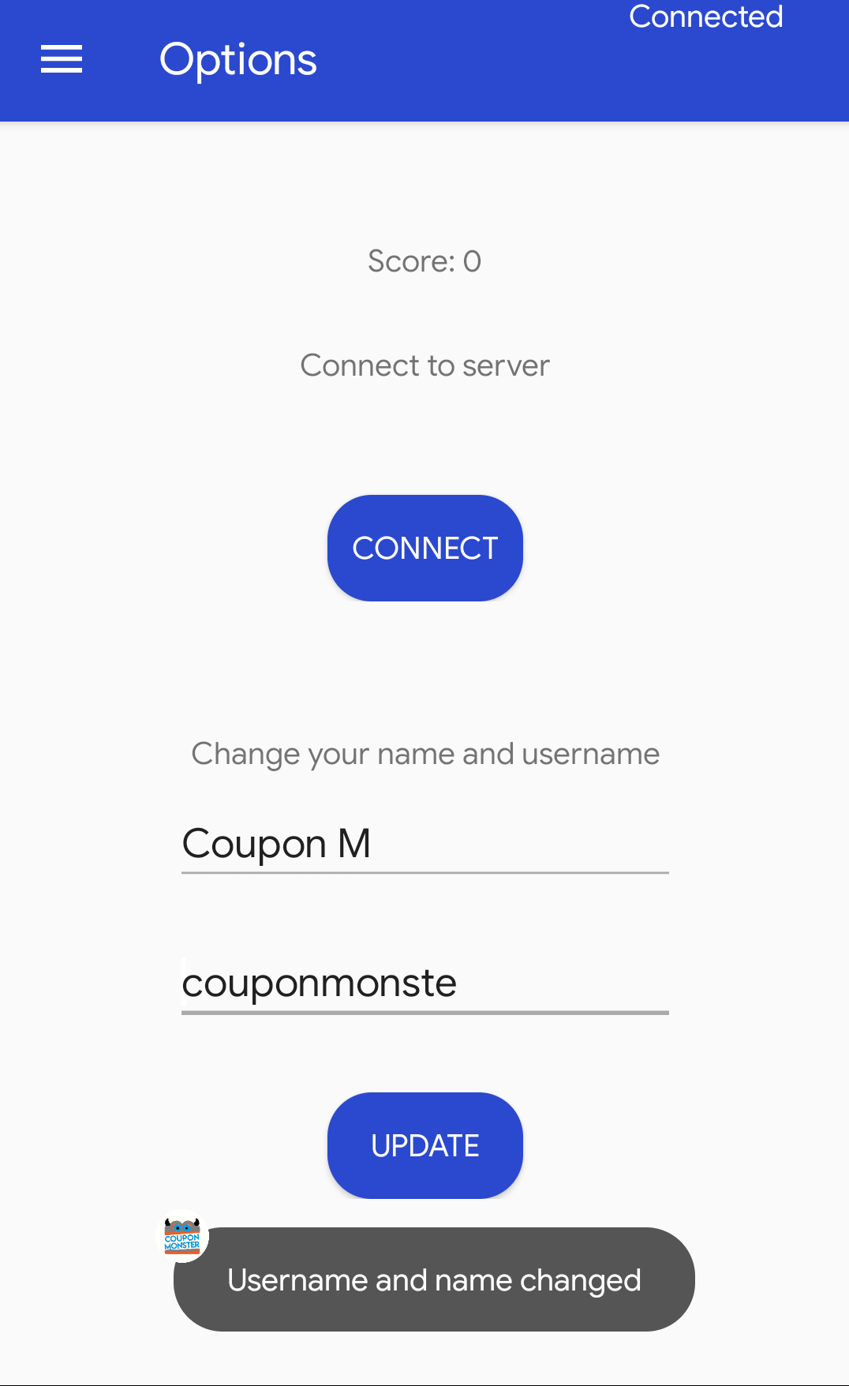
Toast Messages
Notifications shown to user are done via toast messages:
When someone earns a coupon -> username and coupon difficulty.
In online people tab, refreshing status.
Submission, submission result,
Username and/or name change result
Connect button -> Reconnecting result

Slide 9
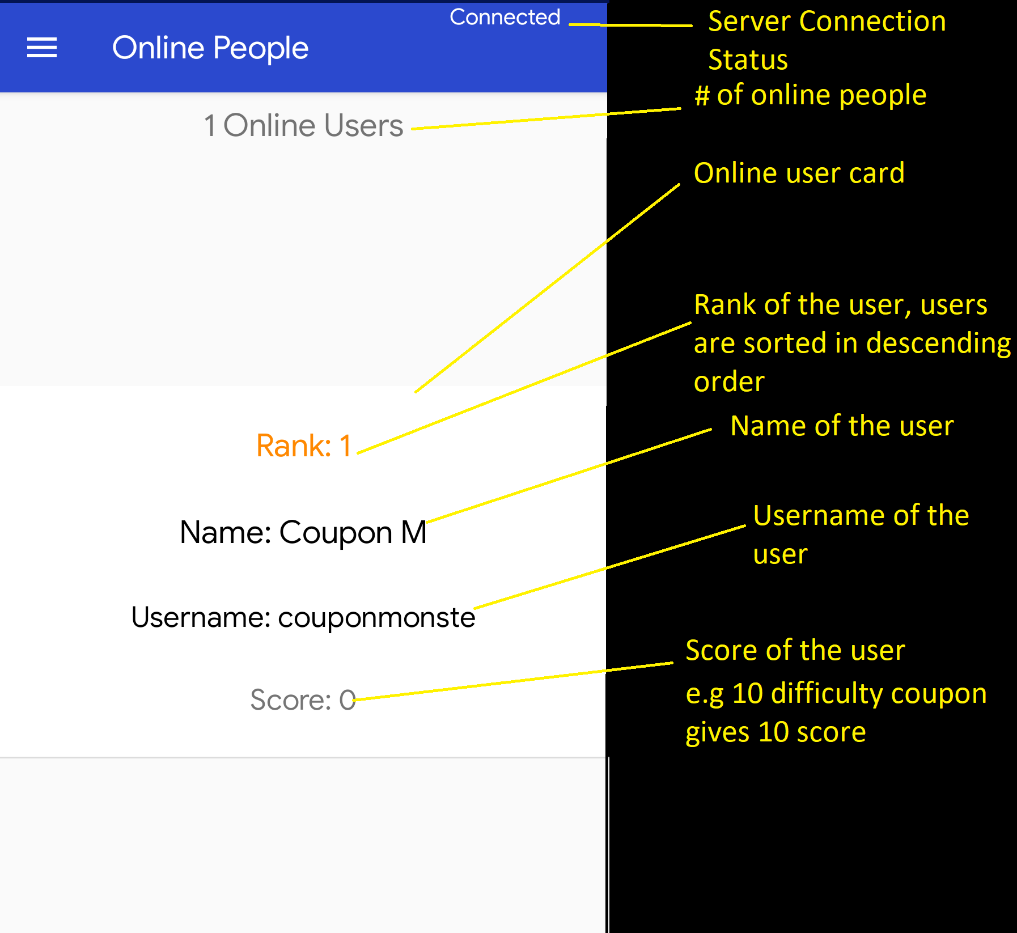
ONLINE PEOPLE

Slide 10
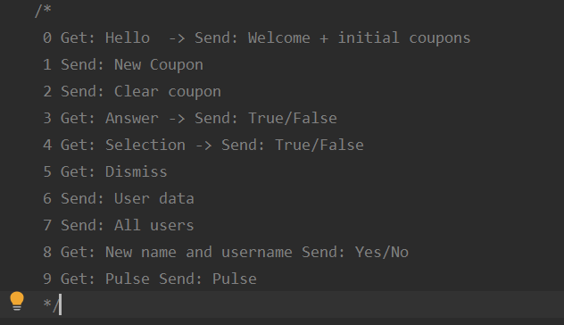
SOURCE CODE- BACKEND
Server starts a new thread for each connection.
Server message types:
1-Broadcast
2-Broadcast
3-Single
4-Single
5-Broadcast
6-Single
7,8,9-Single

Slide 11
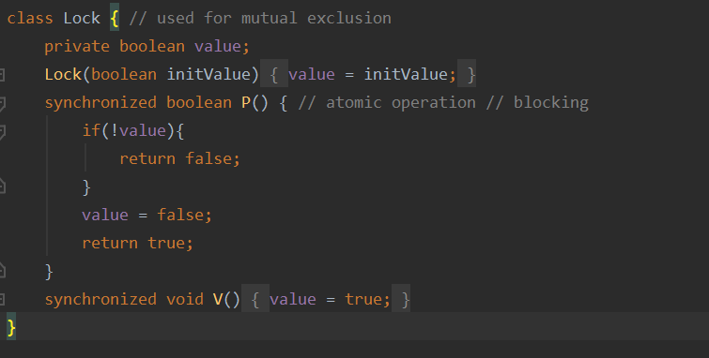
LOCK As BıNARY SEMAPHORE
Each coupon has a lock associated with it.
Frontend send a request for its communication thread to acquire lock of a coupon.
No waiting because a user does not want to wait a lot.
Instead if lock is not available inform user so that he or she continues.
Initial value is true.

Slide 12
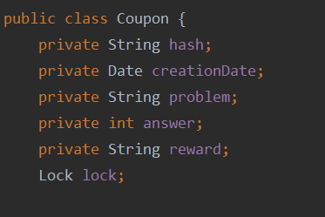
COUPON REPRESENTATION

Slide 13
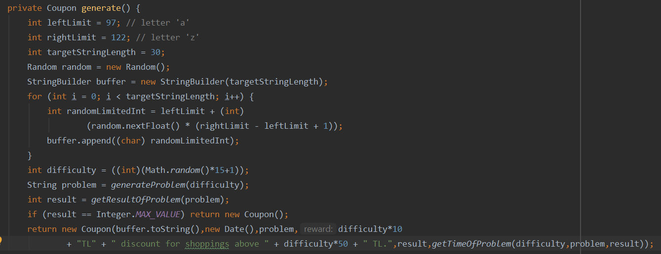
RANDOM COUPON GENERATION
There is a producer thread that produces random coupons with difficulty range [1,15] in a random number of seconds that is between [1-15] seconds.

Slide 14
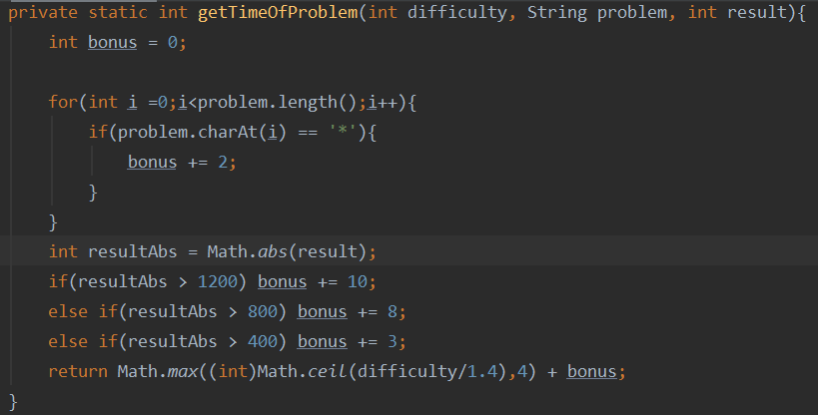
RANDOM Tıme
Tried to make solving time fair with random problems.
If the result’s absolute value is big, bonus time is given.
For each multiply, extra time is given.

Slide 15
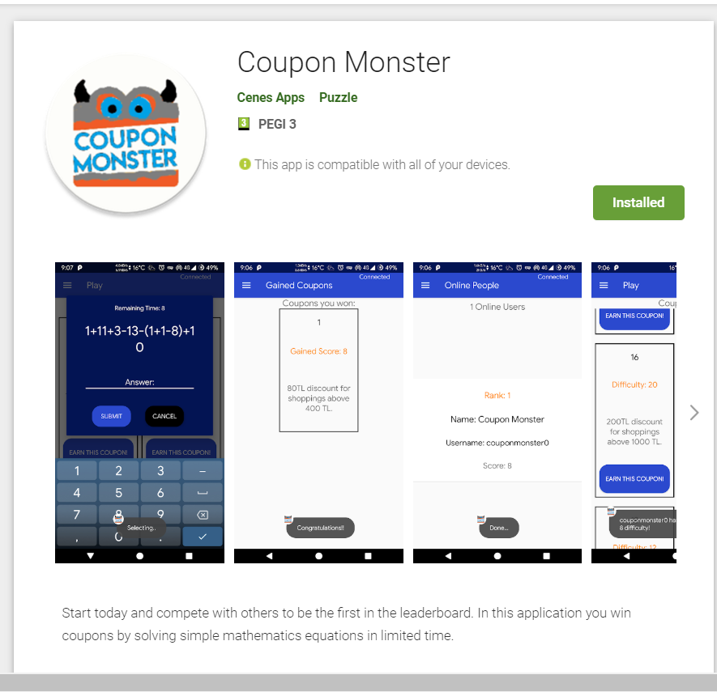
DEMO
You can install application from the apk link at piazza
Or you can use play store link:
https://play.google.com/store/apps/details?id=com.srknzl.couponmonster

Slide 16
Thanks FOR LISTENING
Contact:
Serkan Özel
serkan.ozel@boun.edu.tr

